Slide 1

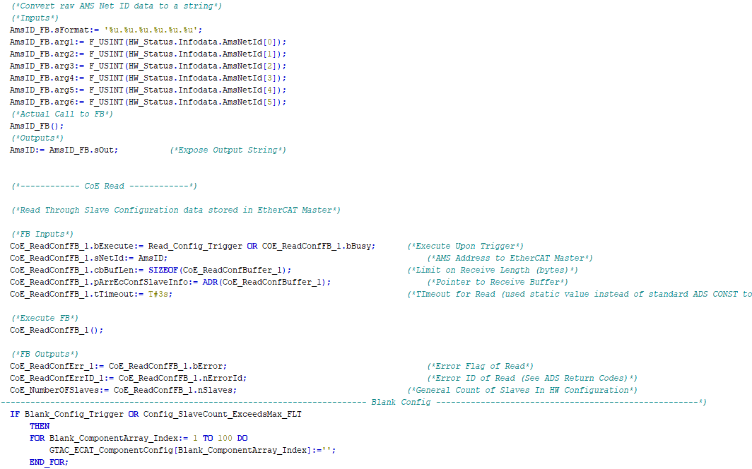

Controls Training
Part 2:
Framework Overview - PLC

Slide 2
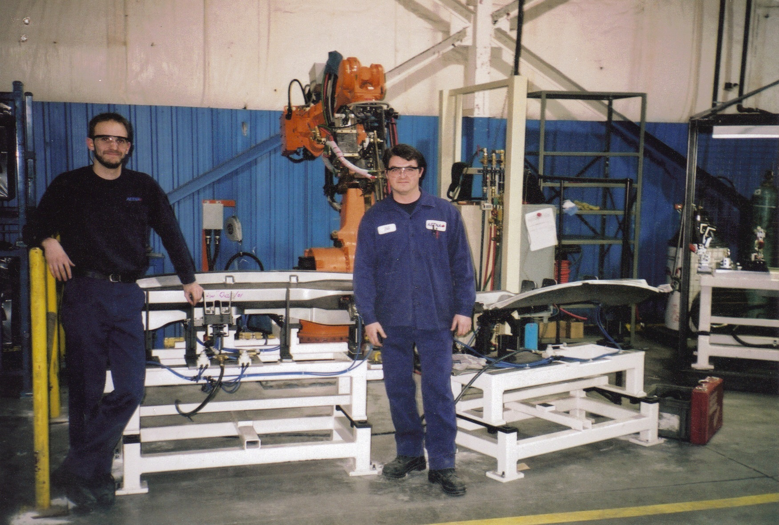
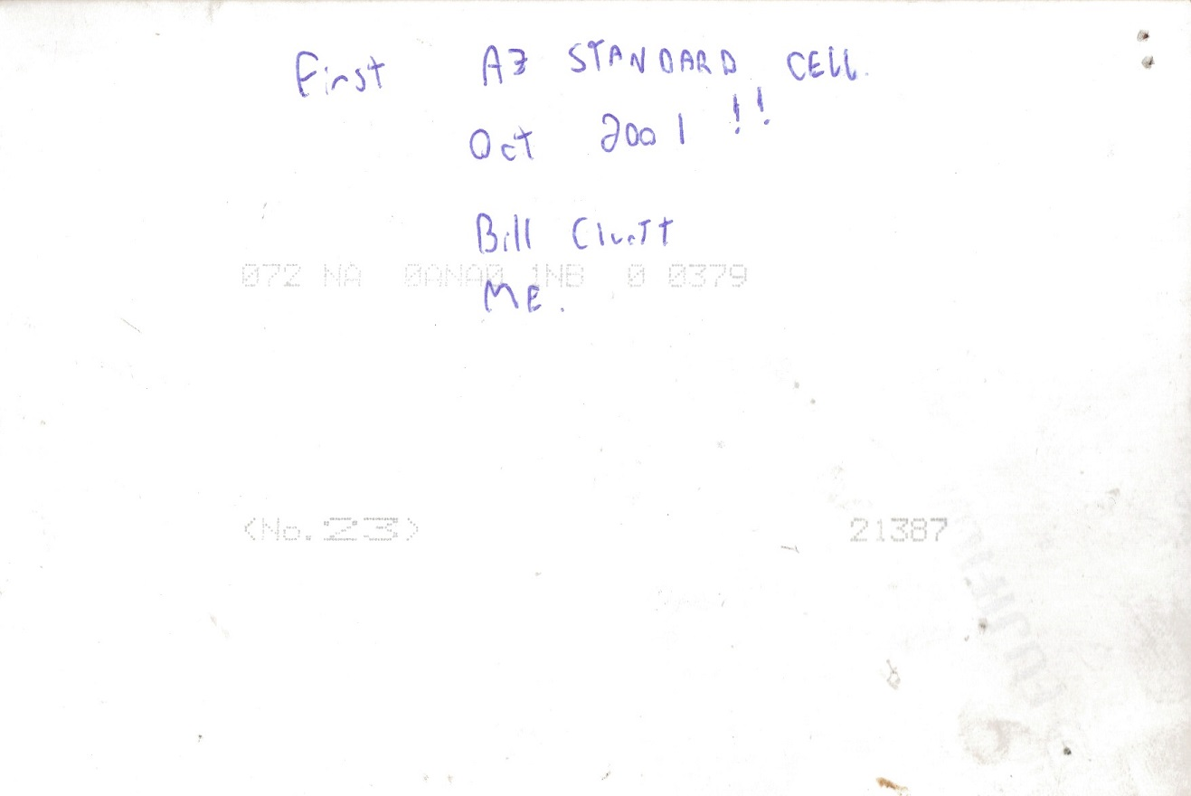
But first, some background:
Why and When
While operating as Aetna Manufacturing (later to become AZ Automotive, a Tier 1 parts supplier to Cami Automotive) and after struggling through multiple machine launches on machines built by outside integrators, there became a need to develop and in-house integration group to design, build and continuously improve automated machines and process for our own manufacturing needs.
Some of the group’s directive were as follows:
Develop a set of standards to be followed in the development of all new machines
Adopt methods to ensure conformance to applicable government standards (ANSI and CSA at the time)
Continuously monitor the successes and failures of each machine launch, from design stage right on to the machine’s EOL, to fine tune over - all designs
Develop standardize set of mechanical designs, electrical designs and software tools to ensure machine consistency and reduce engineering and deployment times
The integration group was started somewhere between late
1999 -> 2000 by Chris Hurley, Bill Cluett and Brent Lekx-Toniolo
to tackle the above.

Slide 3
But first, some background:
FW History
As years went by, experience was gained from multiple program / plant launches as well as working with key partners in the automation industry on several beta level projects. As a result, the Framework (aka FW) evolved both in terms of Controls / Robot Platforms as well as the size and complexity of the code base.
Here is a list of some of the major FW revisions to date:
ASSC01x: AB Controls + Nachi Robots
ASSC02x: Pro-Face (Digital Electronics) Controls + Nachi Robots or Motoman Robots
ASSC03x: Siemens Controls + Motoman Robots
ASSC040-045 : Beckhoff WinCE TC2 Controls + Motoman Robots
SSCC046+: Beckhoff WinCE TC2 Controls + Kuka Robots (Sodecia take-over ~2011/12)
SSCC5xx: Beckhoff Win7 TC2 Controls + Kuka Robots
SSCC6xx: Beckhoff Win7 / 10 TC3 Controls + Kuka Robots

Slide 4
Before we dive in:
Terminology
As you gain exposure to working on GTAC machine projects you will note a few common terms that are used often, below is a list of some you may encounter:
The Machine Package – Is the collection of all packages pertaining to a machine project. This includes documentation templates, software packages (such as the FW), setup and getting started guides and a folder structure to store everything in. This is the package you will obtain when starting a new machine project.
The Framework (FW) – Is the software packages (PLC and UI) contained in the Machine Package. The FW is a software starting point to be used, by Application Programmers, as a set of tools to work with towards deploying their machine.

Slide 5

Diving in:
The FW
Let’s look at the FW

Slide 6
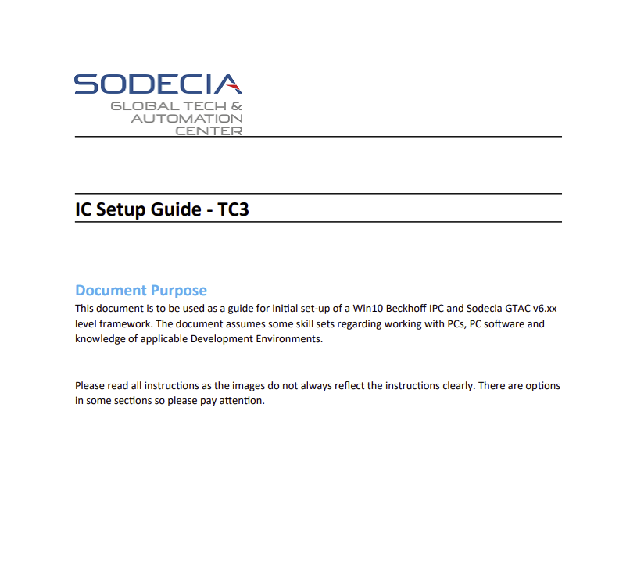
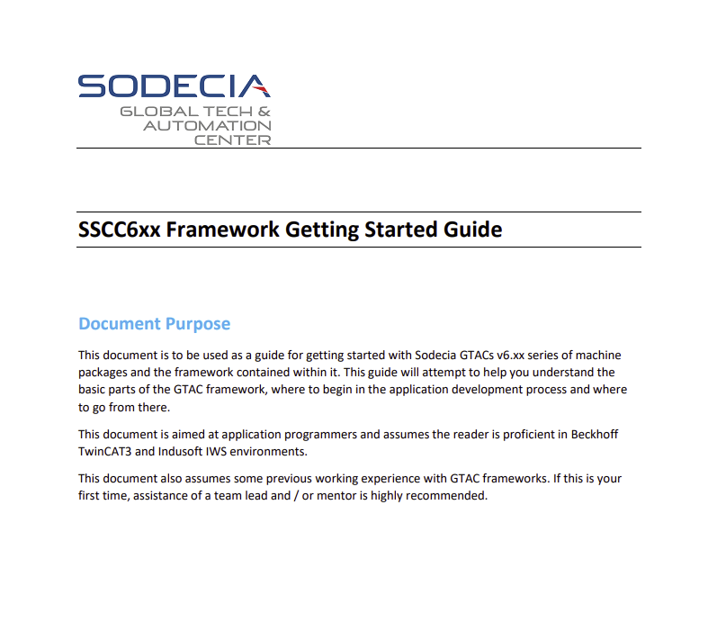


Where to Begin

Slide 7
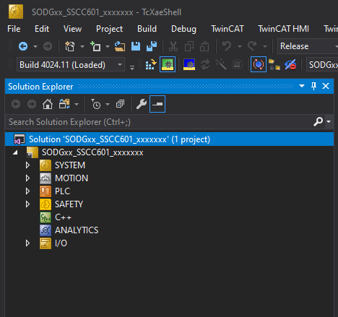
PLC Major Sections
The Sky High View

Slide 8
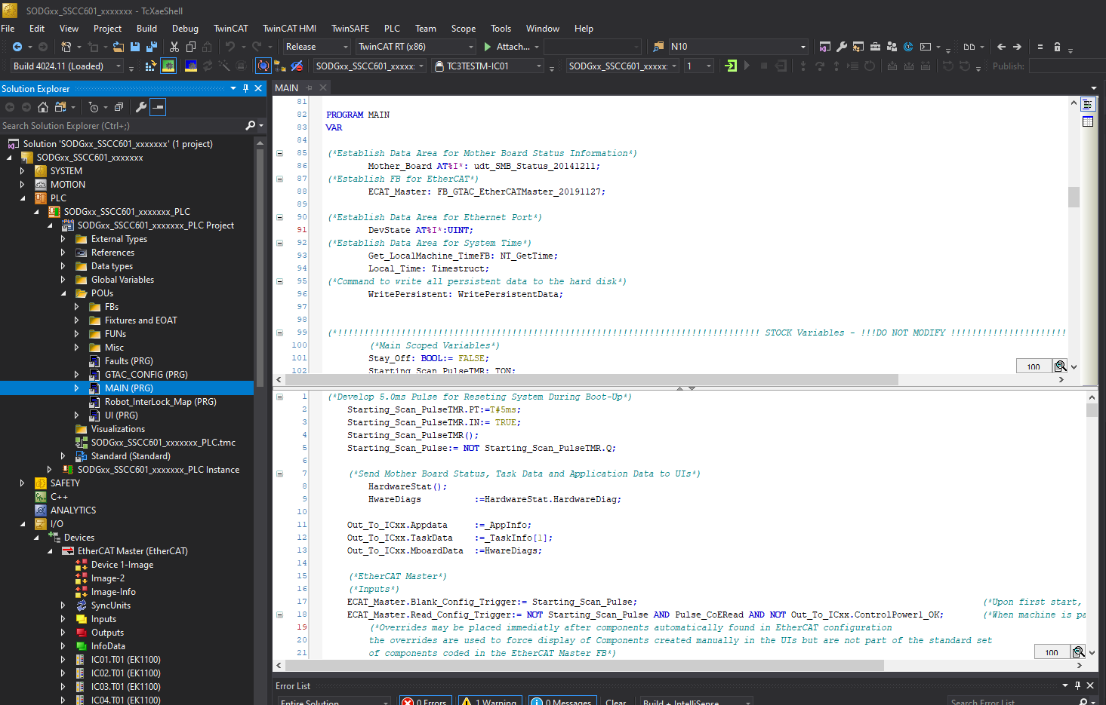
PLC Major Sections
Let’s go to Main!

Slide 9
PLC Major Sections
Hierarchy
FB Instances
Main
Progs
Actions
Ecat Master
GTAC Config
UI
Faults
Robot Interlock Map
Task Id Record
Cell Services
Ped Stations
Ancillary Equipment
Servo Motion
PD01
SS01
ESW01
EOATs
ICs
Robots
SS02
ESW02
ESW03
PED[1]
...
ST01…05
SL01…04
Laser01…
SIC01…
Etc.
SD[1]
...
EOAT01
…
IC01…08
R01
…
…
PED[30]
…
SD[30]
…
EOAT10
Fix01…
…
Fix16
…
R30
Fix101…
…
Fix112

Slide 10
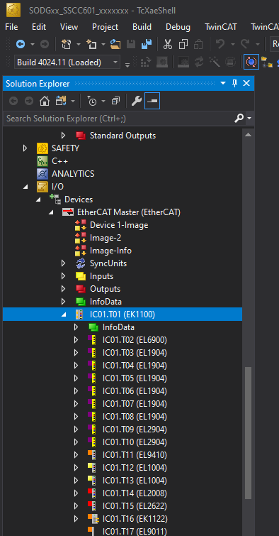
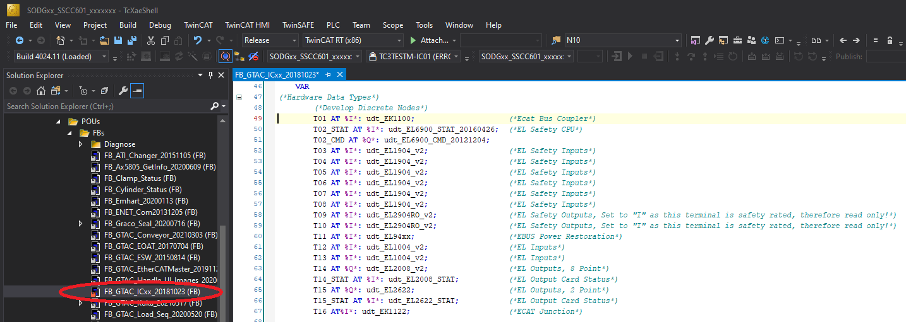
I/O

Slide 11
Best Practices
To quote a good friend, software development in the industrial automation sector back in the early 2000s was much like the wild west: you did what you wanted, stole what you could, and shot those that got in the way. Much of our industry is still a little lacking in terms of standards. Nobody will tell you line by line how to code your machine to work, that is an expectation of the profession. That said, years of experience has taught us some Best Practices that should be adhered to, both in terms of working with the FW and while working on software packages, as a whole.
WHEN IN DOUBT, ASK: The FW is a large code base, no single person knows it inside and out so do not be worried if you hit a section you don’t understand or are looking to do something but unsure if the FW already has the functionality built in. It’s not always obvious……take a deep breath, try your best and in doubt, ask.
COMMENT YOUR CODE: Commenting and whitespace shows a level of professionalism, makes code easier to read and understand and helps both you and others who must look at your code years later. Remember, we ship machines all over the world, the code will be looked at by a number of people and may be in production for over a decade. Are you really going to remember what you wrote 10 years ago? Not likely……
BE TENACIOUS and PROFESSIONAL: There will always be pressure to get the job done as quickly as possible, get used to it. Your job is to produce well thought out, reliable code. Don’t be afraid to push back a bit if you need more time to do the job properly, I can’t promise you will always get it but at least express some level of desire to do the job well. “It works” is NOT justification for saying the code / job is complete.

Slide 12

So far so good?
What’s next?
Questions

Slide 13

Thanks for your time

